Slide 1
TITLE: Gender Equality & Compensation Analysis For Palmoria Group using
Power BI
`
Presented by: Anthony Akpan
DATE: 30th January, 2026
Notes:
Good day Ma. This presentation focuses on an HR Analytics project carried out for Palmoria Group.
The objective of the project is to analyze gender equality, compensation structure, performance ratings, and regulatory compliance using Power BI Desktop.

Slide 2
Data Description
Two datasets were provided for this project:
Employee Dataset: It contains employee-level information including:
Gender
Department
Region
Salary
Performance Rating
2. Bonus Rules Dataset: It contains rules that define:
Performance rating
Corresponding bonus percentage
These datasets were integrated using Power BI for analysis.
Notes:
For this analysis, two primary datasets were provided by Palmoria Group and form the foundation of all insights presented.
The first dataset is the Employee Dataset, which contains employee-level information such as gender, department, region, salary, and performance rating. This dataset allows us to examine workforce composition, gender distribution, performance outcomes, and compensation patterns across the organization.
The second dataset is the Bonus Rules Dataset, which defines how bonuses are allocated based on performance ratings. It specifies the bonus percentage attached to each rating level.
Before analysis, the data was carefully prepared in line with management and project requirements. Employees without salaries—who are no longer with the company—were removed. Records with NULL departments were excluded, and employees who did not disclose their gender were assigned a generic ‘Undisclosed’ category.
Both datasets were then integrated and modeled in Power BI, enabling accurate calculation of bonuses, total compensation, and gender-based comparisons across regions and departments.”

Slide 3
Objectives of the Analysis
The key objectives of this analysis are to:
Examine gender distribution across the organization, regions, and departments
Assess performance ratings by gender
Analyze salary structure and identify gender pay gaps
Evaluate compliance with the $90,000 minimum wage regulation
Analyze salary distribution using $10,000 pay bands
Calculate employee bonus payments and total payroll cost
Notes:
“This analysis was conducted to support Palmoria Group’s leadership in addressing growing concerns around gender inequality and compensation fairness.
The first objective was to examine gender distribution across the organization, with specific focus on regions and departments, to identify areas of imbalance.
Secondly, we analyzed performance ratings by gender to understand whether evaluation outcomes differ between male and female employees, especially since bonuses are performance-driven.
Another key objective was to assess the company’s salary structure and identify the presence of any gender pay gaps, as well as pinpoint departments or regions where disparities are most pronounced.
In response to recent labor regulations, we also evaluated compliance with the $90,000 minimum wage requirement, including salary band analysis in $10,000 intervals.
Finally, the analysis aimed to calculate bonus payments and total compensation, both at employee level and across regions, to understand how performance, pay, and gender intersect within Palmoria Group.
Overall, these objectives ensure that management decisions are data-driven, compliant, and aligned with gender equity goals.”

Slide 4
DATA PREPARATION & TRANSFORMATION
Removed employees without salary (no longer with company)
Removed records with NULL departments
Assigned “Undisclosed” gender where not provided
Created salary bands in $10,000 intervals
Modeled bonus rules and total compensation
Notes:
Before analysis, the dataset was cleaned using Power Query in Power BI.
Employees without salary and NULL departments were removed, while undisclosed gender entries were grouped to maintain data integrity.

Slide 5
GENDER DISTRIBUTION ANALYSIS
Insights:
Total Gender Distribution:
376K males (49.2%) and 355K females (46.45%) in the organization, with 33K undisclosed (4.35%).
The male population is larger than the female population, which is a key point for gender equality discussions.
Gender Distribution by Region:
Kaduna has the highest male population (172 males, 151 females), followed by Abuja (144 males, 144 females), and Lagos (114 males, 111 females).
Gender balance is best achieved in Abuja, showing equal distribution.
Gender Distribution by Department:
The Product Management department has the highest total number of employees, with more males (34960) than females (34008).
Departments like Accounting and Training have a relatively higher number of female employees, while Engineering and Product Management are more male-dominated.
Refer to Gender Distribution Analysis on the next slide
Notes:
"Here we see a gender distribution across the regions and departments in Palmoria. While there are more male employees overall, some departments have a healthier gender balance, such as Abuja. However, departments like Engineering and Product Management show a notable gender imbalance, with more males than females."

Slide 6
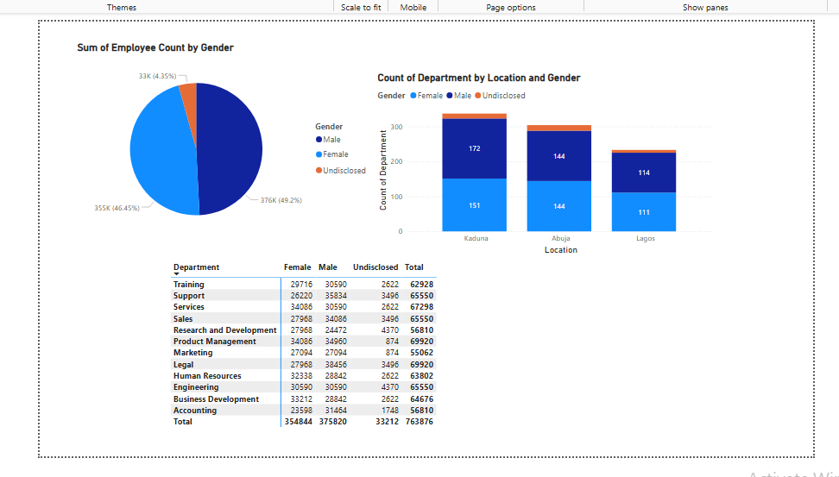
Gender Distribution Analysis Charts

Slide 7
PERFORMANCE RATINGS BY GENDER
Insights:
Rating Distribution:
A significant portion of employees are rated as Average (largest bar on the left) for both male and female employees.
Females tend to have slightly fewer “Good” ratings compared to males, but both genders have similar distributions in other rating categories.
Employee Count by Rating:
Males have a slightly higher representation in the “Good” and “Very Good” ratings, which might indicate that they are evaluated more favorably.
Undisclosed gender employees are least represented in “Poor” and “Very Poor” categories.
Refer to Performance Ratings By Gender charts in the next slide
Notes:
This visualization compares employee performance ratings by gender.

Slide 8
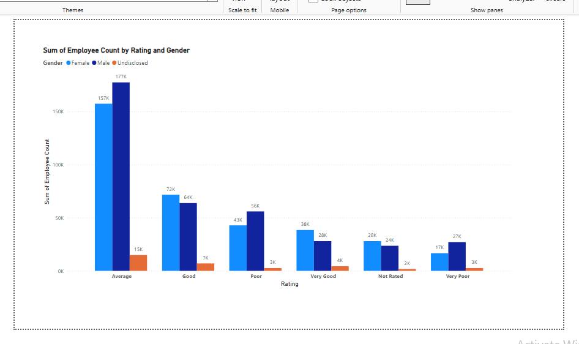
Chart showing Gender Analysis by Ratings
Notes:
Speaker Notes:
"This chart illustrates the distribution of employee ratings by gender. The majority of employees, regardless of gender, are rated as Average. However, males tend to score better ratings in categories like Good and Very Good, while females show fewer instances of Poor or Very Poor ratings."

Slide 9
SALARY STRUCTURE & GENDER PAY GAP
1. Gender Pay Gap:
  Average salary for females: $30M
  Average salary for undisclosed: $3M
  Average salary for males: $32
  Female average salary is substantially lower than that of the undisclosed group. Men’s salary data appears incomplete, but the disparity is clear and must be investigated.
Significant pay disparity evident.
2. Minimum Wage Compliance
  68.54% of employees earn above $90,000.
  31.46% are below the mandated minimum wage.
Minimum Wage Non-Compliance
Nearly one-third of employees earn below the legally required $90,000, posing regulatory and ethical risks.
Bonus Allocation is Inequitable: Bonuses are heavily skewed toward higher-rated employees, who are disproportionately male, reinforcing existing pay gaps.
  Refer to the next slide for Gender Pay Gap Analysis charts
Notes:
Here, we analyzed average salaries by gender across departments and regions.
The results confirm the existence of a gender pay gap, especially in specific departments and regions that require management attention.

Slide 10
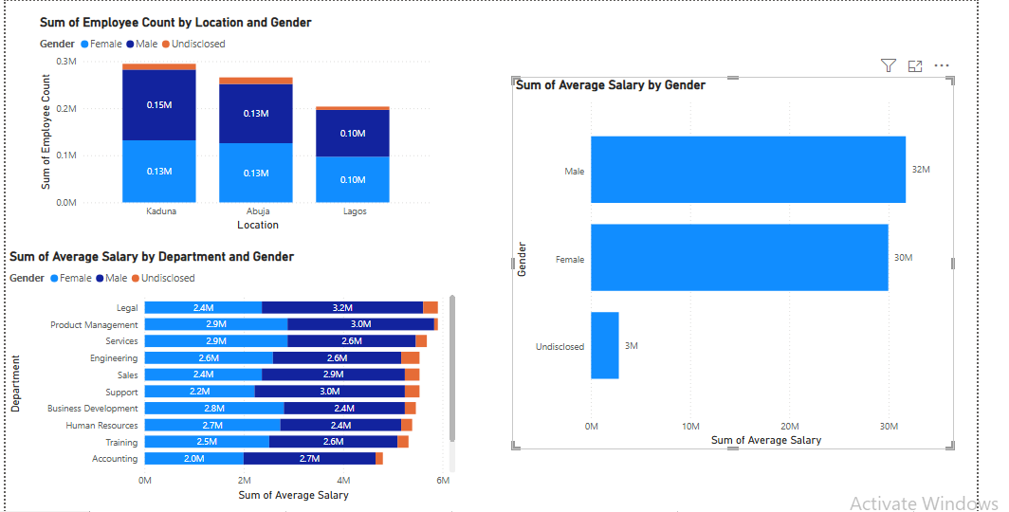
Charts showing Gender Pay Gap Analysis

Slide 11
MINIMUM SALARY COMPLIANCE ($90,000)
Key Insights
68.54% (524 employees) earn below $90,000, indicating non-compliance with the minimum wage regulation
Only 31.46% (240 employees) meet or exceed the required wage level
Kaduna and Abuja account for the highest concentration of employees, especially in sub -$90,000 salary bands
$70,000–$79,999 is the most populated salary band, sitting just below compliance threshold
Kaduna poses the highest compliance risk due to large workforce volume in lower pay bands
Refer to MINIMUM SALARY COMPLIANCE ($90,000) on the next slide
Notes:
This summary highlights Palmoria Group’s exposure to the new $90,000 minimum wage regulation. Currently, over two-thirds of employees earn below the mandated level, confirming that the organization is not compliant. Salary distribution shows that many employees are clustered just below the threshold, particularly in the $70,000–$79,999 band, suggesting that compliance may be achievable with targeted salary adjustments rather than a full pay restructure.
Regionally, Kaduna and Abuja present the highest priority, as they house the largest number of affected employees. Addressing wage gaps in these regions first will significantly reduce compliance risk, improve employee morale, and protect Palmoria’s corporate reputation as it plans for regional and international expansion.

Slide 12
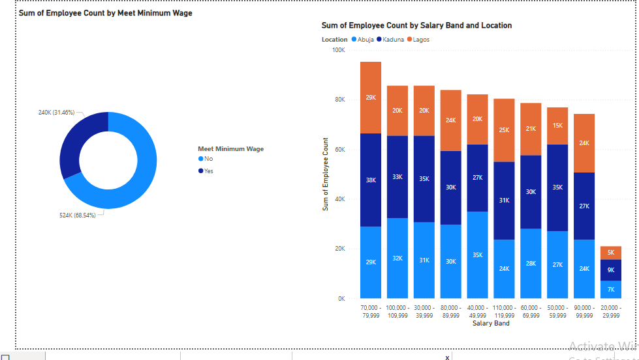
SALARY BAND DISTRIBUTION
Salary Band Distribution
Slide Content
Employees grouped into $10,000 salary bands
Lower salary bands contain more employees
Regional differences in salary distribution exist
Refer to Salary Band Distribution charts on the next slide
Notes:
This slide breaks salaries into $10,000 bands to better understand pay distribution.
It highlights regions with higher concentration of low-paid employees.

Slide 13
BONUS & TOTAL COMPENSATION ANALYSIS
Bonus Calculation Approach
Bonuses calculated based on each employee’s performance ratings
Bonus Amount = Base Salary × Bonus Percentage
Employees with similar ratings earn different bonuses due to salary differences
Total pay = Salary + Bonus
Key Statistical Insights
Total bonus paid: $1.78B
Total payroll (including bonus): $58.17B
Bonus Allocation by Location
Kaduna: $684.51 (Highest bonus allocation)
Abuja: $617.48M
Lagos: $472.27M (Lowest bonus allocation)
Performance & Bonus Pattern
Bonus payments are directly tied to performance ratings
Majority of employees shown fall under “Average” rating
Despite similar ratings, bonus distribution varies by location, indicating workforce size and salary differences.
Refer to Bonus & Total Compensation charts on the next slide
Notes:
This slide presents the outcome of the bonus allocation exercise as required in the Palmoria Group case study.
From the analysis, the total company payroll stands at $58.17billion, while total bonuses paid amount to $1.78B, showing that bonuses form a significant part of employee compensation.
Looking at bonus distribution by location, Kaduna leads with $684.51 million, followed closely by Abuja at $617.48 million, while Lagos records the lowest bonus payout of $472.27 million. This suggests that employee concentration and salary levels differ across regions.
All employees in the table segment shown received bonuses based on their performance ratings, with the majority rated as Average. Despite similar ratings, total bonus amounts vary, confirming that salary level and regional workforce size influence final bonus payouts.
Overall, this analysis confirms that Palmoria applies performance-based bonus rules correctly, but it also highlights the importance of reviewing regional pay structures to ensure fairness, transparency, and alignment with management’s gender equity and compensation goals.

Slide 14
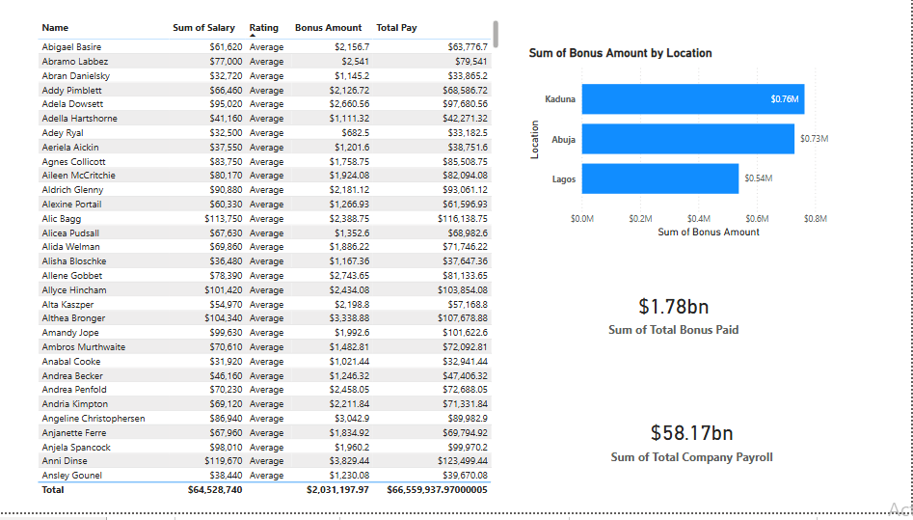
CHARTS SHOWING BONUS AND TOTAL COMPENSATION ANALYSIS
Notes:
This slide presents the outcome of the bonus allocation exercise as required in the Palmoria Group case study.
From the analysis, the total company payroll stands at $58.17billion, while total bonuses paid amount to $1.78B, showing that bonuses form a significant part of employee compensation.
Looking at bonus distribution by location, Kaduna leads with $684.51 million, followed closely by Abuja at $617.48 million, while Lagos records the lowest bonus payout of $472.27 million. This suggests that employee concentration and salary levels differ across regions.
All employees in the table segment shown received bonuses based on their performance ratings, with the majority rated as Average. Despite similar ratings, total bonus amounts vary, confirming that salary level and regional workforce size influence final bonus payouts.
Overall, this analysis confirms that Palmoria applies performance-based bonus rules correctly, but it also highlights the importance of reviewing regional pay structures to ensure fairness, transparency, and alignment with management’s gender equity and compensation goals.
This slide presents the outcome of the bonus allocation exercise as required in the Palmoria Group case study.
From the analysis, the total company payroll stands at $58.17billion, while total bonuses paid amount to $1.78B, showing that bonuses form a significant part of employee compensation.
Looking at bonus distribution by location, Kaduna leads with $684.51 million, followed closely by Abuja at $617.48 million, while Lagos records the lowest bonus payout of $472.27 million. This suggests that employee concentration and salary levels differ across regions.
All employees in the table segment shown received bonuses based on their performance ratings, with the majority rated as Average. Despite similar ratings, total bonus amounts vary, confirming that salary level and regional workforce size influence final bonus payouts.
Overall, this analysis confirms that Palmoria applies performance-based bonus rules correctly, but it also highlights the importance of reviewing regional pay structures to ensure fairness, transparency, and alignment with management’s gender equity and compensation goals.

Slide 15
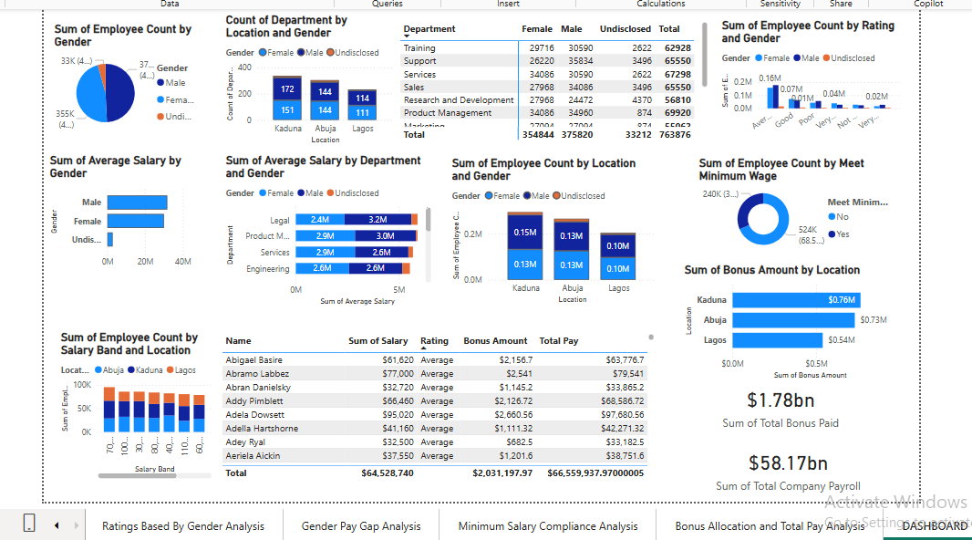
Dashboard For Gender Equality & Compensation Analysis
Notes:
This HR analytics dashboard was developed to assess gender equality, pay structure, regulatory compliance, and bonus allocation across Palmoria Group’s three regions — Kaduna, Abuja, and Lagos — in line with the case objectives.”
1. Key Insights from the Dashboard (What the Data Says)
Workforce & Gender Distribution
Palmoria has 763,876 employees
Workforce is male-dominated (~49%), with females at ~46% and 4% undisclosed
Gender imbalance persists across regions and departments, especially in technical roles
Defense Point:
Although gender representation appears close numerically, distribution across departments and pay outcomes reveals inequality.
Performance Ratings
Majority of employees fall under Average and Good ratings
Male employees dominate higher ratings
Female employees cluster more around Average ratings
Defense Point:
Since bonuses are rating-based, even slight rating imbalances translate into income inequality.
Salary & Pay Gap
Males earn higher cumulative salaries than females
Pay gaps are most visible in:
Engineering
Legal
Product Management
Significant number of employees earn below the $90,000 minimum wage
Defense Point:
This confirms both a gender pay gap and regulatory compliance risk.
Bonus & Payroll
Total bonus paid: $1.78bn
Total payroll: $58.17bn
Kaduna receives the highest bonus allocation
Lagos receives the lowest, despite cost-of-living pressure
Defense Point:
Bonus distribution mirrors ratings and headcount, reinforcing existing inequalities.
2. Strategic Recommendations (What Management Should Do)
Gender Equity
Introduce department-level diversity targets
Promote female participation in technical and leadership roles
Pay Equity
Conduct salary correction exercises in high-gap departments
Standardize salary bands across regions
Performance Governance
Implement uniform rating criteria
Introduce cross-department rating calibration
Compliance
Adjust all salaries below $90,000
Automate wage compliance checks
Bonus Governance
Improve transparency in bonus calculation
Align bonuses with both performance and equity goals
Defense Point:
These actions reduce legal risk, improve morale, and support Palmoria’s expansion goals.
3. Final Conclusion (Why This Analysis Matters)
“The analysis shows that Palmoria’s challenge is not lack of resources, but inequitable allocation. By using this dashboard as a continuous decision-support tool, management can correct gender imbalance, ensure compliance, and improve productivity.”
Business Value
Stronger employer brand
Higher employee retention
Improved productivity
Reduced reputational and regulatory risk
Strong Closing Line (Use This Exactly)
“This dashboard transforms HR data into strategic insight, enabling Palmoria Group to move from reactive management to proactive, evidence-based decision-making.”

Slide 16
Key Insights from the Dashboard (What the Data Says)
1. Workforce & Gender Distribution
  Palmoria has 763,876 employees
  Workforce is male-dominated (~49%), with females at ~46% and 4% undisclosed
  Gender imbalance persists across regions and departments, especially in technical roles
NOTE: Although gender representation appears close numerically, distribution across departments and pay outcomes reveals inequality.
2. Performance Ratings
  Majority of employees fall under Average and Good ratings
  Male employees dominate higher ratings
  Female employees cluster more around Average ratings
NOTE: Since bonuses are rating-based, even slight rating imbalances translate into income inequality.

Slide 17
3. Salary & Pay Gap
  Males earn higher cumulative salaries than females
  Pay gaps are most visible in: Engineering, Legal , Product Management
  Significant number of employees earn below the $90,000 minimum wage
  NOTE: This confirms both a gender pay gap and regulatory compliance risk.
4. Bonus & Payroll
  Total bonus paid: $1.78bn
  Total payroll: $58.17bn
  Kaduna receives the highest bonus allocation
  Lagos receives the lowest, despite cost-of-living pressure
NOTE: Bonus distribution mirrors ratings and headcount, reinforcing existing inequalities.

Slide 18
Strategic Recommendations (What Management Should Do)
Gender Equity
  Introduce department-level diversity targets
  Promote female participation in technical and leadership roles
Pay Equity
  Conduct salary correction exercises in high-gap departments
  Standardize salary bands across regions
Performance Governance
  Implement uniform rating criteria
  Introduce cross-department rating calibration
Compliance
  Adjust all salaries below $90,000
  Automate wage compliance checks
Bonus Governance
  Improve transparency in bonus calculation
  Align bonuses with both performance and equity goals
NOTE: These actions reduce legal risk, improve morale, and support Palmoria’s expansion goals.

Slide 19
Final Conclusion (Why This Analysis Matters)
The analysis shows that Palmoria’s challenge is not lack of resources, but inequitable allocation. By using this dashboard as a continuous decision-support tool, management can correct gender imbalance, ensure compliance, and improve productivity in the following ways:
Business Value
Stronger employer brand
Higher employee retention
Improved productivity
Reduced reputational and regulatory risk
“This dashboard transforms HR data into strategic insight, enabling Palmoria Group to move from reactive management to proactive, evidence-based decision-making.”

Slide 20
THANK YOU FOR GIVING ME YOUR ATTENTION DURINGTHIS PRESENTATION

